Slide 1
Real world configuration management
Scott.Weinstein@lab49.com
Practice Head at Lab49
weblogs.asp.net/sweinstein / @ScottWeinstein

Slide 2







We thank the following companies for their gracious sponsorship
Platinum Sponsor
Gold Sponsors
Silver Sponsors

Slide 3
A typical setup
You have a website
It needs configuration info for
Databases
Web services
File shares
Email
Other websites
You have scripts that connect to the same datasources

Slide 4
More constraints
You have multiple development and test environments
Limited hardware
Multiple instances per machine

Slide 5
System diagram
DemoSite
Marketing
Analysis cubes
Product DB
UpdateAccounts.ps1
Ftp Drop
Installer.ps1

Slide 6

Traditional Web.Config
the pit of despair?

Slide 7
Web.config traditional approach
Modify the config at compile time
XML Transform or newer
VS2010 web.config transformation

Slide 8
Issues with this approach
Conflates parameter configuration with structural configuration
DB connection string vs
<customErrors mode="RemoteOnly" />
Hard to change the environment you point to at development time
Does not support multiple entry points well
Lack of runtime and deploy time diagnostics
Lack of unit test ability

Slide 9

A Solution

Slide 10
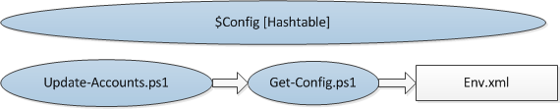
Simple from PowerShell
Any script, such as Update-Accounts.ps1
Calls Get-Config.ps1
Reads Env.xml
Sets $Config object, with some string formatting

Slide 11
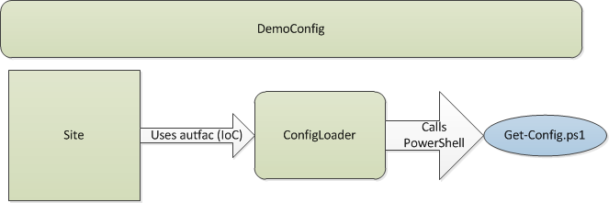
A simple approach
All config in a single xml file
A powershell script to transform to useable values
C# strongly typed façade

Slide 12
Code & Demo
Env.xml
Get-Config.ps1
ConfigLoader
EnvEvaluator
Test-DeploymentEnv.ps1
Change env for development

Slide 13
Other ways to harden your app
Exception logging
Send all exceptions, to disk, and to support email
Usage logging

